Slide 1
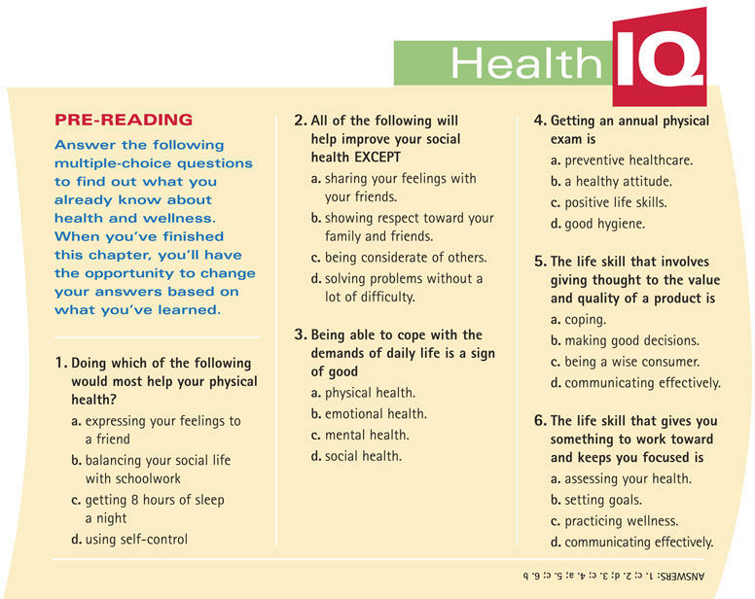
Chapter 1
Health and Wellness

Slide 2
Chapter 1
Health and Wellness
Lessons
Lesson 1 What Is Health?
Lesson 2 What Influences Your Health?
Lesson 3 Healthy Attitudes
Lesson 4 Life Skills to Improve Your Health

Slide 3
Chapter 1
Lesson 1 What Is Health?
Bellringer
Make a list of habits that lead to good health.

Slide 4
Chapter 1
Lesson 1 What Is Health?
Objectives
Identify the four parts of health.
Explain how the four parts of health affect your wellness.
Notes:
Header – dark yellow 24 points Arial Bold
Body text – white 20 points Arial Bold, dark yellow highlights
Bullets – dark yellow
Copyright – white 12 points Arial
Size:
Height: 7.52"
Width: 10.02"
Scale: 70%
Position on slide:
Horizontal - 0"
Vertical - 0"

Slide 5
Chapter 1
Lesson 1 What Is Health?
Start Off Write
What are some ways that you can take care of your health?
Notes:
Header – dark yellow 24 points Arial Bold
Body text – white 20 points Arial Bold, dark yellow highlights
Bullets – dark yellow
Copyright – white 12 points Arial
Size:
Height: 7.52"
Width: 10.02"
Scale: 70%
Position on slide:
Horizontal - 0"
Vertical - 0"

Slide 6
Chapter 1
Lesson 1 What Is Health?
Your Physical Health
Things that you can do to maintain your physical health include the following:
1. eating balanced meals
2. exercising
3. getting 8 hours of sleep every night
4. maintaining good hygiene
5. avoiding alcohol, drugs, and tobacco
Notes:
Header – dark yellow 24 points Arial Bold
Body text – white 20 points Arial Bold, dark yellow highlights
Bullets – dark yellow
Copyright – white 12 points Arial
Size:
Height: 7.52"
Width: 10.02"
Scale: 70%
Position on slide:
Horizontal - 0"
Vertical - 0"

Slide 7
Chapter 1
Lesson 1 What Is Health?
Your Emotional Health
What Is Emotional Health? Emotional health is the way you recognize and deal with your feelings.
Healthy Emotions People with emotional health are able to:
express emotions in calm and healthy ways
deal with sadness and ask help if needed
accept their strengths and weaknesses
Notes:
Header – dark yellow 24 points Arial Bold
Body text – white 20 points Arial Bold, dark yellow highlights
Bullets – dark yellow
Copyright – white 12 points Arial
Size:
Height: 7.52"
Width: 10.02"
Scale: 70%
Position on slide:
Horizontal - 0"
Vertical - 0"

Slide 8
Chapter 1
Lesson 1 What Is Health?
Your Mental Health
What Is Mental Health? Mental health is the way you cope with the demands of daily life.
Good Mental Health Having good mental health means that you can:
solve problems with little trouble
be open to new ideas
adjust to change
Notes:
Header – dark yellow 24 points Arial Bold
Body text – white 20 points Arial Bold, dark yellow highlights
Bullets – dark yellow
Copyright – white 12 points Arial
Size:
Height: 7.52"
Width: 10.02"
Scale: 70%
Position on slide:
Horizontal - 0"
Vertical - 0"

Slide 9
Chapter 1
Lesson 1 What Is Health?
Your Social Health
What Is Social Health? The way you interact with other people describes your social health.
Notes:
Header – dark yellow 24 points Arial Bold
Body text – white 20 points Arial Bold, dark yellow highlights
Bullets – dark yellow
Copyright – white 12 points Arial
Size:
Height: 7.52"
Width: 10.02"
Scale: 70%
Position on slide:
Horizontal - 0"
Vertical - 0"

Slide 10
Chapter 1
Lesson 1 What Is Health?
Your Social Health
Social Skills Ask yourself these questions:
Are you considerate of other people?
Do you show respect for other people?
Are you dependable?
Do you support your friends when they make good choices?
Do you share your feelings with your friends?
Notes:
Header – dark yellow 24 points Arial Bold
Body text – white 20 points Arial Bold, dark yellow highlights
Bullets – dark yellow
Copyright – white 12 points Arial
Size:
Height: 7.52"
Width: 10.02"
Scale: 70%
Position on slide:
Horizontal - 0"
Vertical - 0"

Slide 11
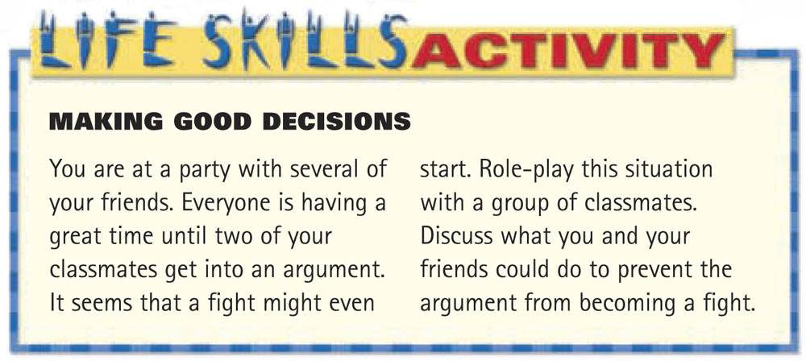
Chapter 1
Lesson 1 What Is Health?
Try this Life Skills Activity to assess your social health.
Notes:
Header – dark yellow 24 points Arial Bold
Body text – white 20 points Arial Bold, dark yellow highlights
Bullets – dark yellow
Copyright – white 12 points Arial
Size:
Height: 7.52"
Width: 10.02"
Scale: 70%
Position on slide:
Horizontal - 0"
Vertical - 0"

Slide 12
Chapter 1
Lesson 1 What Is Health?
What Is Wellness?
Wellness is a state of good health that is achieved by balancing your physical, emotional, mental, and social health.
Notes:
Header – dark yellow 24 points Arial Bold
Body text – white 20 points Arial Bold, dark yellow highlights
Bullets – dark yellow
Copyright – white 12 points Arial
Size:
Height: 7.52"
Width: 10.02"
Scale: 70%
Position on slide:
Horizontal - 0"
Vertical - 0"

Slide 13
Chapter 1
Lesson 1 What Is Health?
What Is Wellness?
Do the following to keep your health balanced:
1. Take care of your body.
2. Deal with stress.
3. Express your feelings in a healthy way.
4. Be considerate.
Take the quiz on the next slide to find out how your wellness rates.
Notes:
Header – dark yellow 24 points Arial Bold
Body text – white 20 points Arial Bold, dark yellow highlights
Bullets – dark yellow
Copyright – white 12 points Arial
Size:
Height: 7.52"
Width: 10.02"
Scale: 70%
Position on slide:
Horizontal - 0"
Vertical - 0"

Slide 14
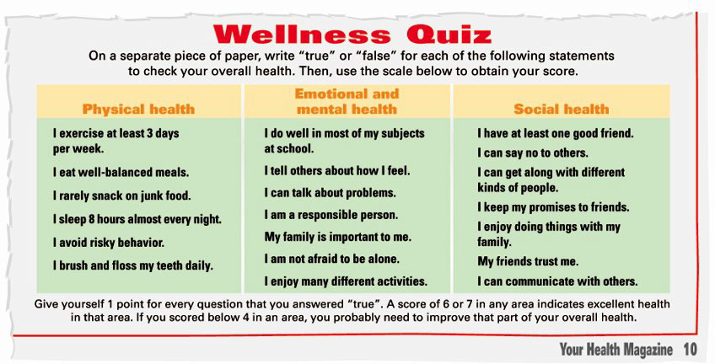
Chapter 1
Lesson 1 What Is Health?
Notes:
Header – dark yellow 24 points Arial Bold
Body text – white 20 points Arial Bold, dark yellow highlights
Bullets – dark yellow
Copyright – white 12 points Arial
Size:
Height: 7.52"
Width: 10.02"
Scale: 70%
Position on slide:
Horizontal - 0"
Vertical - 0"

Slide 15
Chapter 1
Lesson 2 What Influences Your Health?
Bellringer
Is there anything about the environment of your school classroom that you would like to change? Explain your answer.
Notes:
Header – dark yellow 24 points Arial Bold
Body text – white 20 points Arial Bold, dark yellow highlights
Bullets – dark yellow
Copyright – white 12 points Arial
Size:
Height: 7.52"
Width: 10.02"
Scale: 70%
Position on slide:
Horizontal - 0"
Vertical - 0"

Slide 16
Chapter 1
Lesson 2 What Influences Your Health?
Objectives
Explain how heredity influences your health.
Explain how the environment effects your health.
Notes:
Header – dark yellow 24 points Arial Bold
Body text – white 20 points Arial Bold, dark yellow highlights
Bullets – dark yellow
Copyright – white 12 points Arial
Size:
Height: 7.52"
Width: 10.02"
Scale: 70%
Position on slide:
Horizontal - 0"
Vertical - 0"

Slide 17
Chapter 1
Lesson 2 What Influences Your Health?
Start Off Write
Describe how your environment can have a positive effect on your health.
Notes:
Header – dark yellow 24 points Arial Bold
Body text – white 20 points Arial Bold, dark yellow highlights
Bullets – dark yellow
Copyright – white 12 points Arial
Size:
Height: 7.52"
Width: 10.02"
Scale: 70%
Position on slide:
Horizontal - 0"
Vertical - 0"

Slide 18
Chapter 1
Lesson 2 What Influences Your Health?
Who You Are
What Is Heredity? Heredity is the passing down of traits from parents to their biological child.
Inherited Traits Physical traits that can be inherited, or passed down, include height and hair, eye, and skin color. Certain diseases can also be passed down from parent to child.
Notes:
Header – dark yellow 24 points Arial Bold
Body text – white 20 points Arial Bold, dark yellow highlights
Bullets – dark yellow
Copyright – white 12 points Arial
Size:
Height: 7.52"
Width: 10.02"
Scale: 70%
Position on slide:
Horizontal - 0"
Vertical - 0"

Slide 19
Chapter 1
Lesson 2 What Influences Your Health?
What Is Around You?
What Is the Environment? Your environment includes all of the living and nonliving things around you.
The Environment Affects Health Some diseases can be triggered by your environment. Air pollution can trigger asthma, which is a lung disease, and can contribute to allergies. Your emotional and mental health can suffer from noise pollution around your home or school.
Notes:
Header – dark yellow 24 points Arial Bold
Body text – white 20 points Arial Bold, dark yellow highlights
Bullets – dark yellow
Copyright – white 12 points Arial
Size:
Height: 7.52"
Width: 10.02"
Scale: 70%
Position on slide:
Horizontal - 0"
Vertical - 0"

Slide 20
Chapter 1
Lesson 3 Healthy Attitudes
Bellringer
Describe three healthy choices that you made in the last 24 hours.
Notes:
Header – dark yellow 24 points Arial Bold
Body text – white 20 points Arial Bold, dark yellow highlights
Bullets – dark yellow
Copyright – white 12 points Arial
Size:
Height: 7.52"
Width: 10.02"
Scale: 70%
Position on slide:
Horizontal - 0"
Vertical - 0"

Slide 21
Chapter 1
Lesson 3 Healthy Attitudes
Objectives
Explain the relationship between your lifestyle and your health.
Explain what you can do to take control of your health.
Describe how you can make responsible choices about your health.
Notes:
Header – dark yellow 24 points Arial Bold
Body text – white 20 points Arial Bold, dark yellow highlights
Bullets – dark yellow
Copyright – white 12 points Arial
Size:
Height: 7.52"
Width: 10.02"
Scale: 70%
Position on slide:
Horizontal - 0"
Vertical - 0"

Slide 22
Chapter 1
Lesson 3 Healthy Attitudes
Start Off Write
What are two things you could do to improve your health?
Notes:
Header – dark yellow 24 points Arial Bold
Body text – white 20 points Arial Bold, dark yellow highlights
Bullets – dark yellow
Copyright – white 12 points Arial
Size:
Height: 7.52"
Width: 10.02"
Scale: 70%
Position on slide:
Horizontal - 0"
Vertical - 0"

Slide 23
Chapter 1
Lesson 3 Healthy Attitudes
Healthy Living
Having a Healthy Lifestyle Every day, you make choices that influence your health. Your choices make up your lifestyle, or set of behaviors that you live by.
Having a Good Attitude Your attitude is a way of acting, thinking, or feeling that causes you to make one choice over another. A good attitude will allow you to listen to advice about healthy living.
Notes:
Header – dark yellow 24 points Arial Bold
Body text – white 20 points Arial Bold, dark yellow highlights
Bullets – dark yellow
Copyright – white 12 points Arial
Size:
Height: 7.52"
Width: 10.02"
Scale: 70%
Position on slide:
Horizontal - 0"
Vertical - 0"

Slide 24
Chapter 1
Lesson 3 Healthy Attitudes
Controlling Your Health
You have the ability to control much of your health.
If one part of your health isn’t as good as it should be, make a decision to improve that part of your health.
Remember that all four parts of your health are equally important for overall wellness.
Notes:
Header – dark yellow 24 points Arial Bold
Body text – white 20 points Arial Bold, dark yellow highlights
Bullets – dark yellow
Copyright – white 12 points Arial
Size:
Height: 7.52"
Width: 10.02"
Scale: 70%
Position on slide:
Horizontal - 0"
Vertical - 0"

Slide 25
Chapter 1
Lesson 3 Healthy Attitudes
Being Responsible
Taking care of yourself involves practicing preventive healthcare.
Preventative healthcare is taking steps to prevent illness and accidents before they happen.
Preventive healthcare involves more than yearly checkups. For example, when you eat right, avoid risky behavior, and buckle your seat belt, you are protecting yourself from possible illness or injury.

Slide 26
Chapter 1
Lesson 4 Life Skills to Improve Your Health
Bellringer
In your own words, explain what life skills are.
Notes:
Header – dark yellow 24 points Arial Bold
Body text – white 20 points Arial Bold, dark yellow highlights
Bullets – dark yellow
Copyright – white 12 points Arial
Size:
Height: 7.52"
Width: 10.02"
Scale: 70%
Position on slide:
Horizontal - 0"
Vertical - 0"

Slide 27
Chapter 1
Lesson 4 Life Skills to Improve Your Health
Objectives
Identify the nine life skills that can improve your health.
Identify four ways that using life skills can help you.
Explain how you can check your progress in learning the life skills.
Notes:
Header – dark yellow 24 points Arial Bold
Body text – white 20 points Arial Bold, dark yellow highlights
Bullets – dark yellow
Copyright – white 12 points Arial
Size:
Height: 7.52"
Width: 10.02"
Scale: 70%
Position on slide:
Horizontal - 0"
Vertical - 0"

Slide 28
Chapter 1
Lesson 4 Life Skills to Improve Your Health
Start Off Write
Which life skills are important to you and your health?
Notes:
Header – dark yellow 24 points Arial Bold
Body text – white 20 points Arial Bold, dark yellow highlights
Bullets – dark yellow
Copyright – white 12 points Arial
Size:
Height: 7.52"
Width: 10.02"
Scale: 70%
Position on slide:
Horizontal - 0"
Vertical - 0"

Slide 29
Chapter 1
Lesson 4 Life Skills to Improve Your Health
The Life Skills
Necessary Skills The table on the next slide lists the life skills that can help you maintain a healthy life. Which of these life skills do you already practice well? Which do you need to improve?
Notes:
Header – dark yellow 24 points Arial Bold
Body text – white 20 points Arial Bold, dark yellow highlights
Bullets – dark yellow
Copyright – white 12 points Arial
Size:
Height: 7.52"
Width: 10.02"
Scale: 70%
Position on slide:
Horizontal - 0"
Vertical - 0"

Slide 30
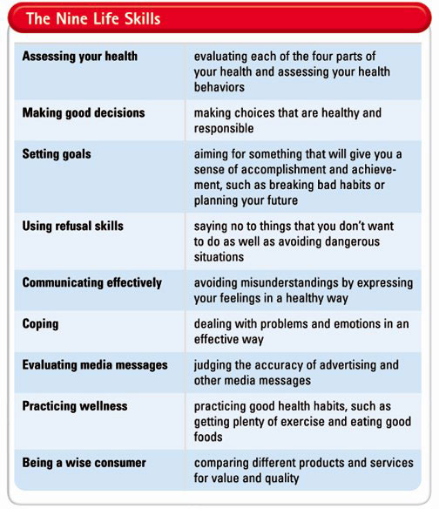
Chapter 1
Lesson 4 Life Skills to Improve Your Health
Notes:
Header – dark yellow 24 points Arial Bold
Body text – white 20 points Arial Bold, dark yellow highlights
Bullets – dark yellow
Copyright – white 12 points Arial
Size:
Height: 7.52"
Width: 10.02"
Scale: 70%
Position on slide:
Horizontal - 0"
Vertical - 0"

Slide 31
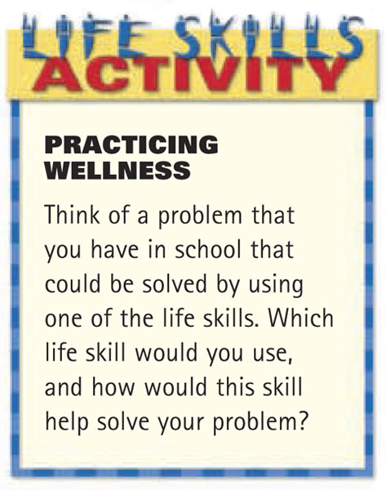
Chapter 1
Lesson 4 Life Skills to Improve Your Health
Using the Life Skills
Remember that the best way to master any skill is to practice it. For example, you can do this Life Skills Activity to practice wellness.
Notes:
Header – dark yellow 24 points Arial Bold
Body text – white 20 points Arial Bold, dark yellow highlights
Bullets – dark yellow
Copyright – white 12 points Arial
Size:
Height: 7.52"
Width: 10.02"
Scale: 70%
Position on slide:
Horizontal - 0"
Vertical - 0"

Slide 32
Chapter 1
Lesson 4 Life Skills to Improve Your Health
Checking Your Progress
To assess your progress in using life skills, ask yourself questions such as:
1. Which skills do I use the most?
2. Which life skills do I feel comfortable using?
3. Which skills do I still need help with?
Notes:
Header – dark yellow 24 points Arial Bold
Body text – white 20 points Arial Bold, dark yellow highlights
Bullets – dark yellow
Copyright – white 12 points Arial
Size:
Height: 7.52"
Width: 10.02"
Scale: 70%
Position on slide:
Horizontal - 0"
Vertical - 0"

Slide 33
Chapter 1
Lesson 4 Life Skills to Improve Your Health
Life Skills and Staying Healthy
Keep Making Good Choices Staying healthy takes some effort. But knowing how and when to use the life skills will make staying healthy easier. Think about how you will use the life skills when you face a problem. If you plan ahead, you will find it much easier to deal with problems when they arise.
Notes:
Header – dark yellow 24 points Arial Bold
Body text – white 20 points Arial Bold, dark yellow highlights
Bullets – dark yellow
Copyright – white 12 points Arial
Size:
Height: 7.52"
Width: 10.02"
Scale: 70%
Position on slide:
Horizontal - 0"
Vertical - 0"

Slide 34
Chapter 1
Health and Wellness
Notes:
Header – dark yellow 24 points Arial Bold
Body text – white 20 points Arial Bold, dark yellow highlights
Bullets – dark yellow
Copyright – white 12 points Arial
Size:
Height: 7.52"
Width: 10.02"
Scale: 70%
Position on slide:
Horizontal - 0"
Vertical - 0"

Slide 35
Chapter 1
Lesson 1 What Is Health?
Notes:
Header – dark yellow 24 points Arial Bold
Body text – white 20 points Arial Bold, dark yellow highlights
Bullets – dark yellow
Copyright – white 12 points Arial
Size:
Height: 7.52"
Width: 10.02"
Scale: 70%
Position on slide:
Horizontal - 0"
Vertical - 0"

Slide 36
Chapter 1
Lesson 4 Life Skills to Improve Your Health
Notes:
Header – dark yellow 24 points Arial Bold
Body text – white 20 points Arial Bold, dark yellow highlights
Bullets – dark yellow
Copyright – white 12 points Arial
Size:
Height: 7.52"
Width: 10.02"
Scale: 70%
Position on slide:
Horizontal - 0"
Vertical - 0"

